Slide 1

Career Hive
Buzzing with Opportunities

Slide 2


SUBMITTED BY
SUBMITTED TO
Nishat Tasnim Niloy
Lecturer
Dept. of Computer Science
& Engineering
Bushra Hoque Sanjana Kazi Supti Asif Ahmed Fahim
2022-1-60-154 2022-2-60-036 2022-1-60-084

Slide 3
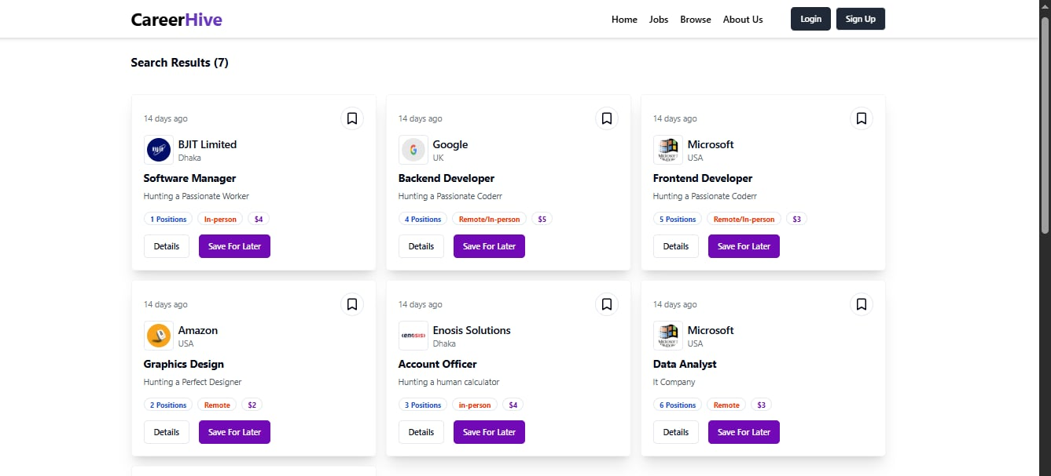
WHAT IS ACTUALLY Carrer Hive
This web-based job portal connects job seekers with companies by offering a streamlined platform for job listings, applications, and candidate management. Users can browse available jobs, apply, and showcase their skills through a dynamic portfolio. Integrated features like an AI-powered chatbot assist with job suggestions, while video interview scheduling allows for real-time virtual hiring. Admins oversee all system activities to ensure smooth, policy-aligned operations for both job seekers and recruiters.

Slide 4



Let’s understand
Specifications
01. This online job portal is designed to provide job seekers with access to a wide range of career-related services, including: • Online job applications • Smart job search and filtering • Interactive chatbot for assistance and job suggestions • Dynamic resume/CV builder for portfolio generation • Video conferencing system for live interview sessions
03. The system is divided into three main modules: • Jobseeker’s Section – Search jobs, build CV, apply, attend interviews • Company’s Section – Post jobs, view applicants, schedule interviews • Administrator’s Section – Manage users, monitor activity, approve/reject processes
Backend Technologies
Express.js – Core web framework for server and routing
bcryptjs – Password hashing for secure login
jsonwebtoken – JWT-based user authentication
multer – Handles file uploads (e.g., images, documents)
cloudinary – Stores and serves user-uploaded media from the cloud
02. The portal is built with a robust backend and modern frontend using scalable, user-friendly design principles. It ensures smooth navigation, fast performance, and responsive interaction across devices.
04. Frontend/Backend Technologies Used: • Next.js – Server-side rendering and routing • React – Component-based UI architecture • Redux – State management • ShadCN – Pre-styled components • TailwindCSS – Utility-first CSS framework • Radix UI – Accessible, unstyled UI primitives

Slide 5

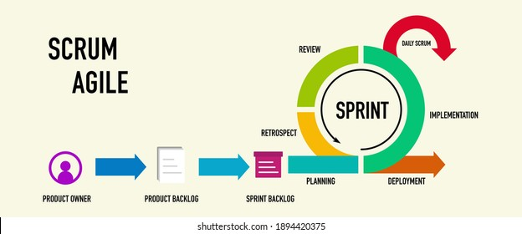
Agile Development using Scrum Methodology
Scrum is a fast, flexible Agile framework that turns big goals into short, focused sprints. Each sprint (2–4 weeks) includes planning, building, testing, and reviewing—ensuring constant progress and real-time adaptation. With its emphasis on teamwork and feedback, Scrum keeps CareerHive evolving with speed and precision.

Slide 6

Career Hive < Benefits of Using Scrum
Flexible to Change 🔄 Easily adapts to new ideas, client needs, or shifting goals.
Faster Feature Delivery 🚀 New updates roll out quickly with every sprint cycle.
Stronger Team Collaboration 🤝 Clear roles and daily stand-ups keep everyone aligned and engaged.
Client-Centered Approach 🧑‍💼 Frequent feedback ensures features match client expectations.
Early Risk Detection 🛡️ Continuous testing and review help catch issues before they grow.

Slide 7

Why Career Hive is the Best Job Portal Platform?
1️⃣ User-Friendly Interface
2️⃣ Smart Job Matching
3️⃣ Real-Time Updates
4️⃣ Secure and Reliable
5️⃣ Comprehensive Search Filters
6️⃣ Integrated Resume Builder
7️⃣ Support for Career Growth
8️⃣ Complete Hiring Solution
9️⃣ AI-Powered Chatbot
🔟 Video Conferencing for Interviews

Slide 8
Why Should People Use or Purchase Career Hive?
💡 Customizable Plans Pay only for what you need — no hidden extras.
💸 Budget-Friendly Options Pick services that match your budget and hiring goals.
⚡ Fast & Efficient Hiring Use chatbots, video interviews, and portfolios to save time.
📊 Full Client Control Track progress and updates in real time.
🔐 Secure & Trusted Data privacy and platform security guaranteed.
🧠 Built for Modern Hiring Everything you need — all in one smart system.

Slide 9

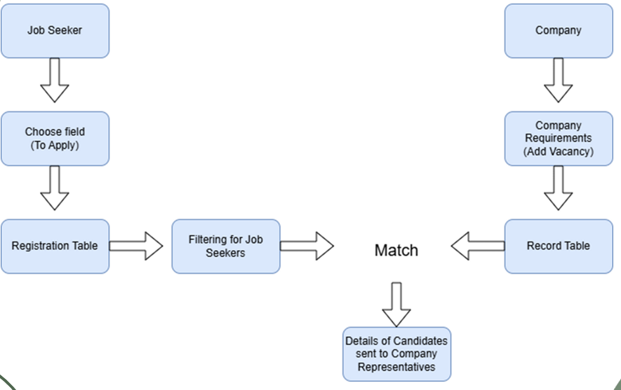
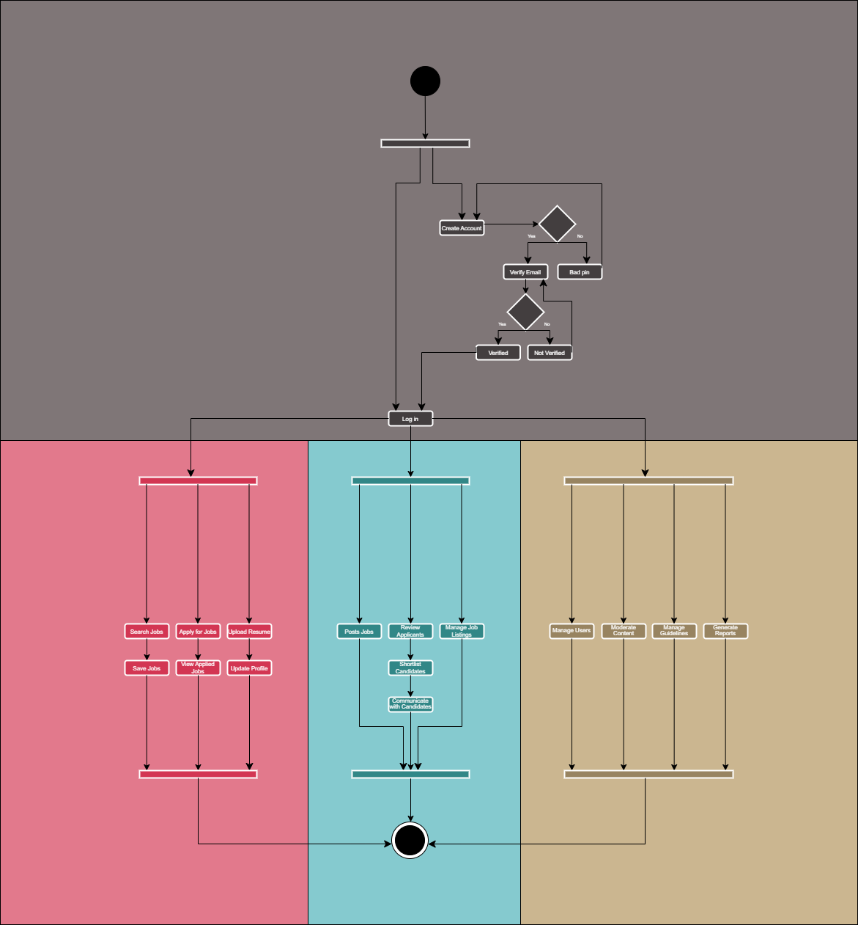
Portal diagram
Activity diagram

Slide 10


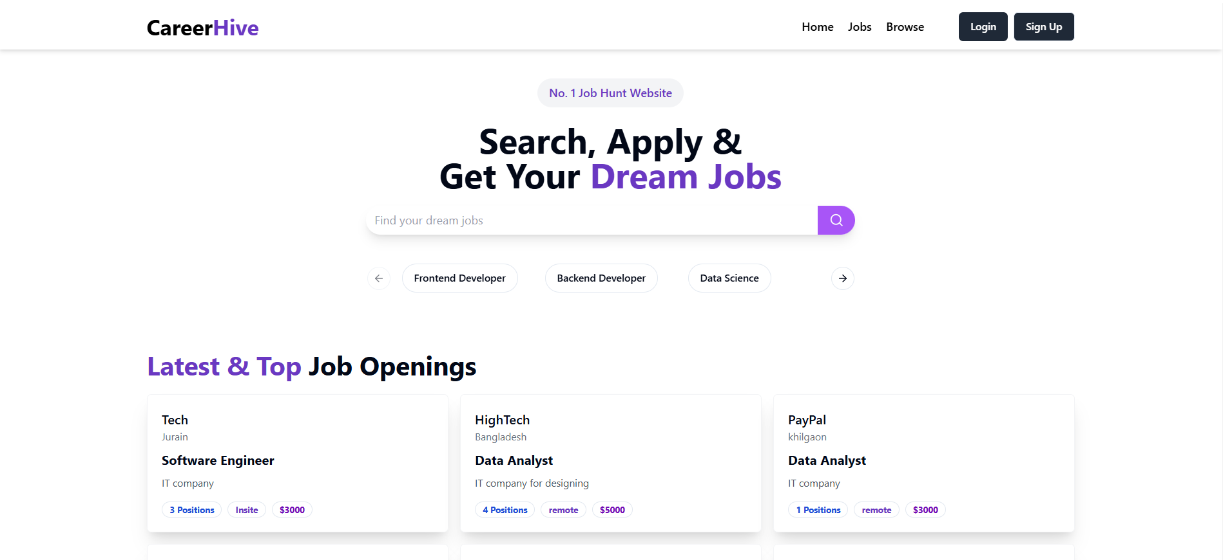

Home page

Slide 11
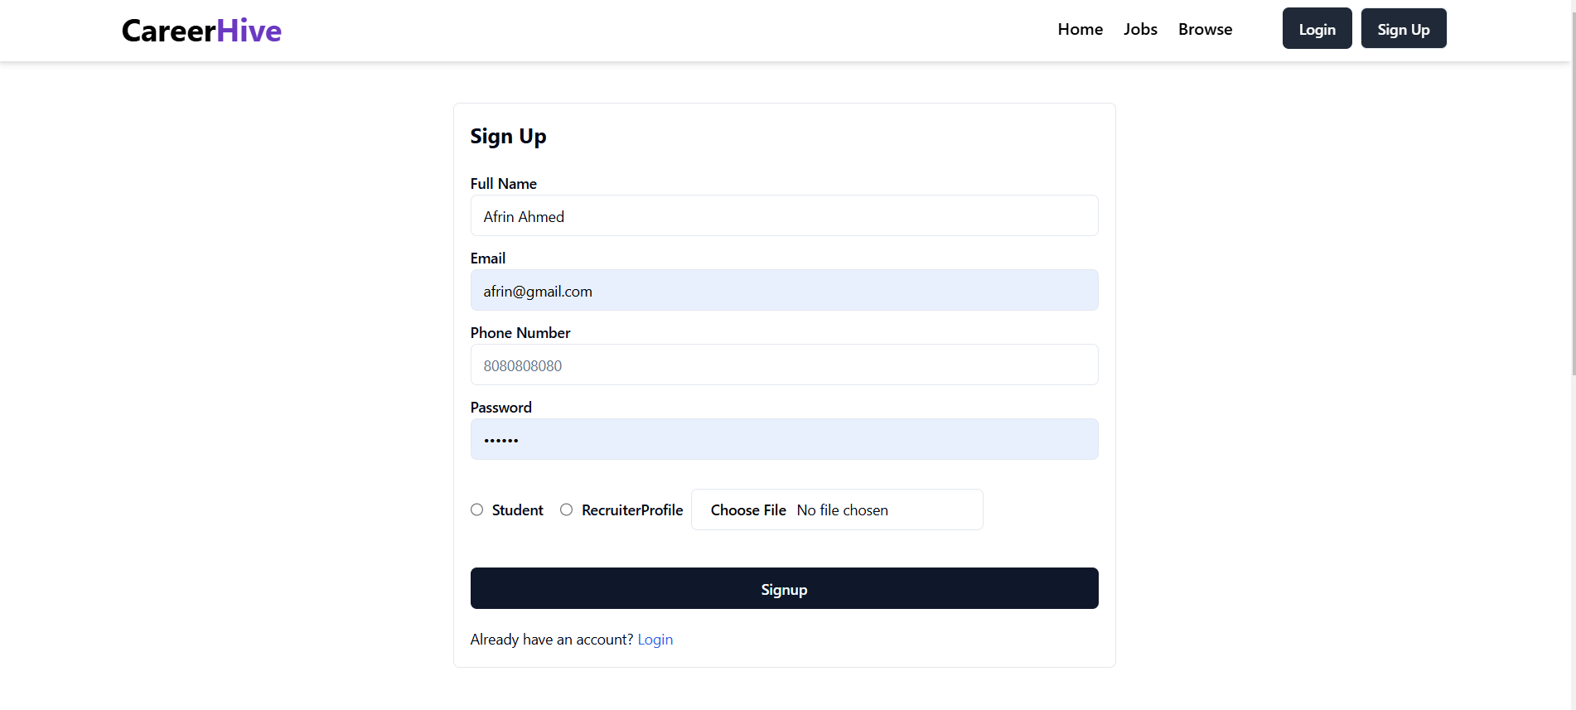
Sign up📌 page

Slide 12


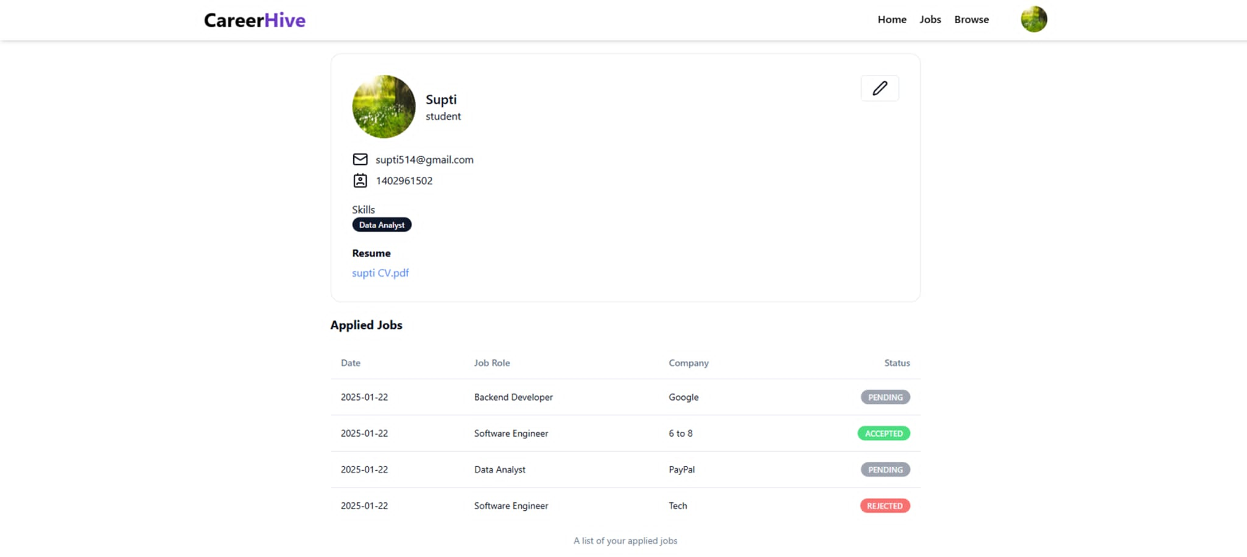
User Profile
Conditional Rendering (Login Status)

Slide 13

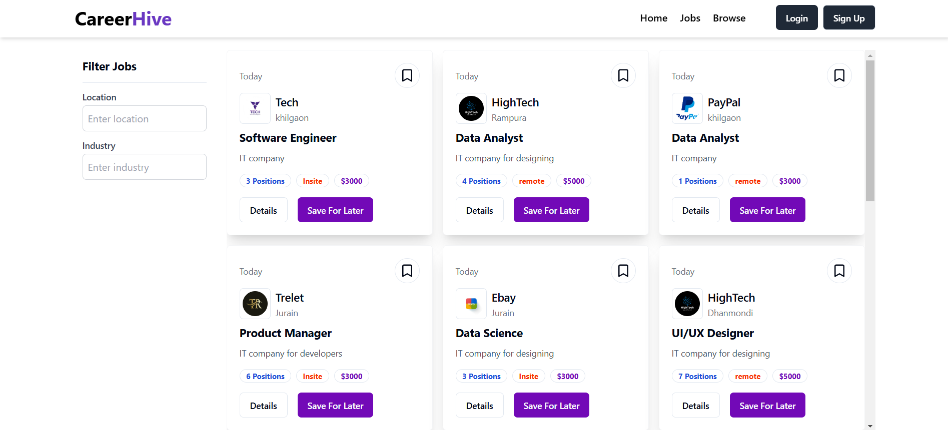
Jobs page

Slide 14

THANKS!
Here is where ending of my presentation

